Slide 1
SWE-4805: Software Verification and Validation
Introduction
Md. Nazmul Haque
Lecturer, IUT
Department of Computer Science and Engineering
Islamic University of Technology
November 19, 2021

Slide 2
Contents
Contents
Requirement verification
Introduction to formal method

Slide 3
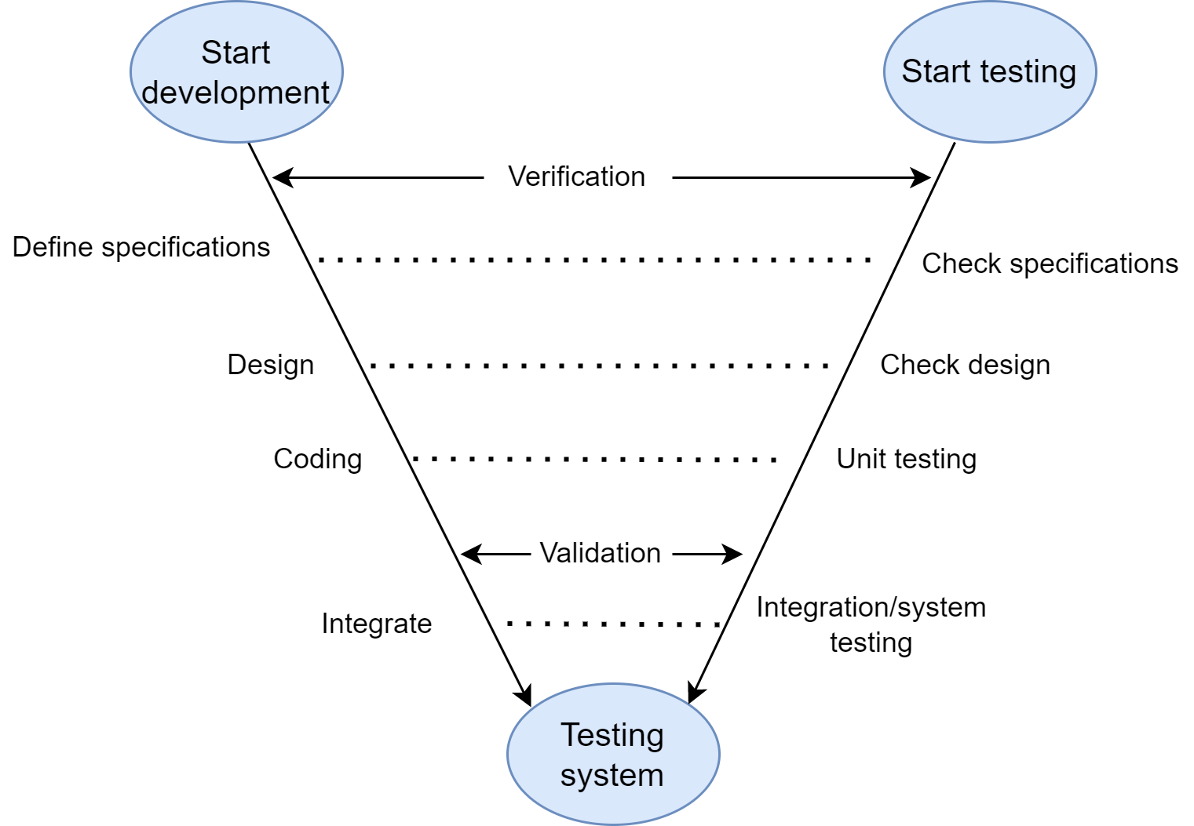
Verification
V & V in Testing
Fig: V-Testing

Slide 4
Testing
Limitations of Testing
Testing can show the presence of errors, but not their absence.
(exhaustive testing viable only for trivial systems)
Representativeness of test cases/injected faults is subjective.
How to test for the unexpected? Rare cases?
Testing is labor-intensive, hence expensive.

Slide 5

Formal method
Complementing Testing: Formal Verification
A Sorting Program
Testing sort()
1. sort({3; 2; 5}) == {2; 3; 5}
2. sort({}) == {}
3. sort({17}) == {17}
Typically missed test cases
1. sort({2; 1; 2}) == {1; 2; 2}
2. sort(null) == exception
3. isPermutation(sort(a); a)

Slide 6
Formal method
Formal Verification as Theorem Proving
Theorem (Correctness of sort()) For any given non-null int array a, calling the program sort(a) returns an int array that is sorted wrt ≤ and is a permutation of a.
However, methodology differs from mathematics:
Formalize the expected property in a logical language
Prove the property with the help of an (semi-)automated tool

Slide 7
Formal method
Formal Verification
Rigorous techniques and tools for the development and analysis of computational (hardware/software) systems.
Applied at various stages of the development cycle
Also used in reverse engineering to model and analyze existing systems
Based on mathematics and symbolic logic (formal)

Slide 8
Formal method
Main Artifacts in Formal Methods
System requirements.
System implementation.
Formal methods rely on
some formal specification of (1)
some formal execution model of (2)
Use tools to verify mechanically that the implementation satisfies (a) according to (b)

Slide 9
Formal method
Specifications
What the system should do
Simple properties
Safety properties: something bad will never happen
Liveness properties: something good will happen eventually
Non-functional properties: runtime, memory, usability, …
“Complete” behavior specification
Equivalence check
Refinement
Data consistency
...

Slide 10
Formal method
Formal Specification
The expression in some formal language and at some level of abstraction of a collection of properties that some system should satisfy [van Lamsweerde]
formal language:
syntax can be mechanically processed and checked
semantics is defined unambiguously by mathematical means
abstraction:
above the level of source code
several levels possible
properties:
expressed in some formal logic
have a well-defined semantics
satisfaction:
ideally (but not always) decided mechanically
based on automated deduction and/or model checking techniques

Slide 11
Formal method
Fundamental Facts
Formalization of system requirements is hard,
Proving properties of systems can be hard

Slide 12
ANY QUESTION ?
THANK YOU !

Slide 13
Acknowledgements
Acknowledgements
[1] Marcus S. Fisher, Software Verification and Validation: An Engineering and Scientific Approach, Springer, 2007 edition, 2006.
[2] Chauhan, Naresh. Software Testing: Principles and Practices. Oxford university press, 2010.
[3] Department of Software Engineering, University of Iowa.

